Slide 1
Weekly Update Concept Erasing on UMM
2026.01.16
Hayeon Jeong

Slide 2
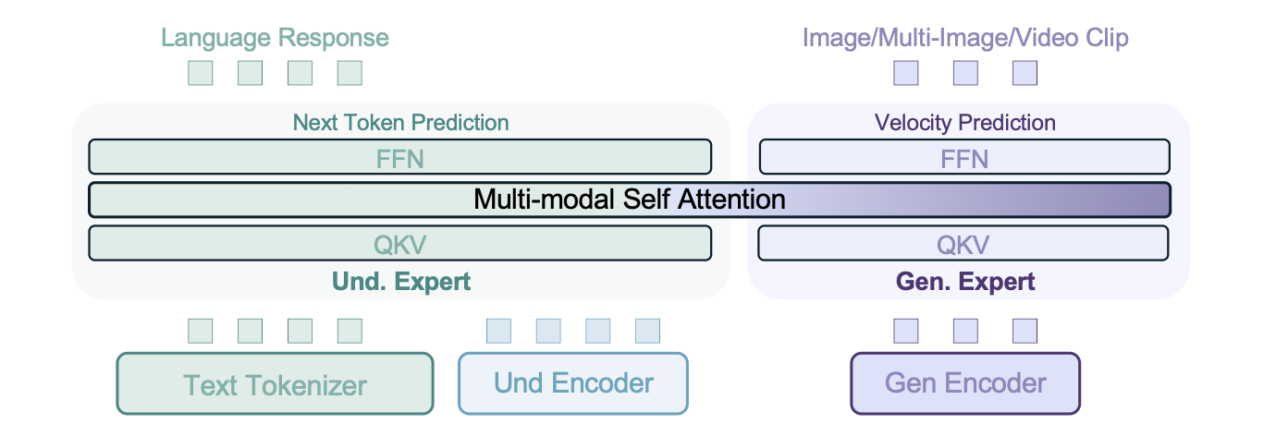
Last Week
x28
x28
Wq, Wk, Wv
Wq_gen, Wk _gen, Wv _gen
[ Multi-modal Self Attention ]
txt
vit
vae
txt
vit
vae

Slide 3
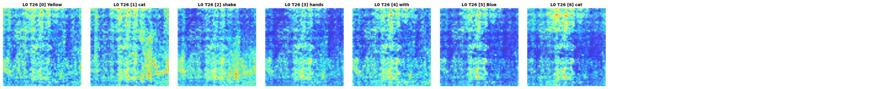
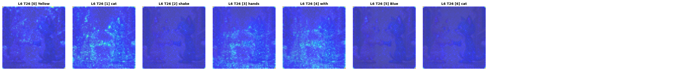
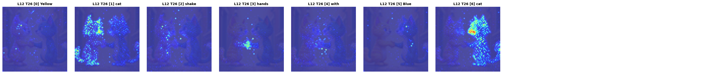

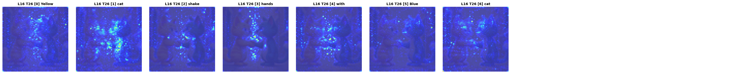
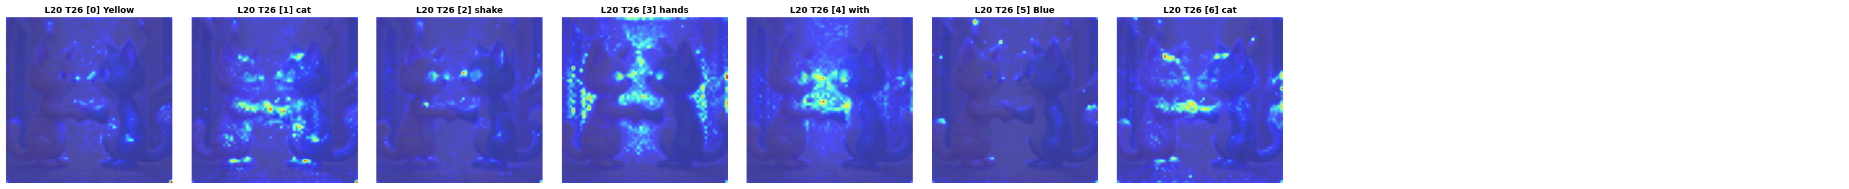
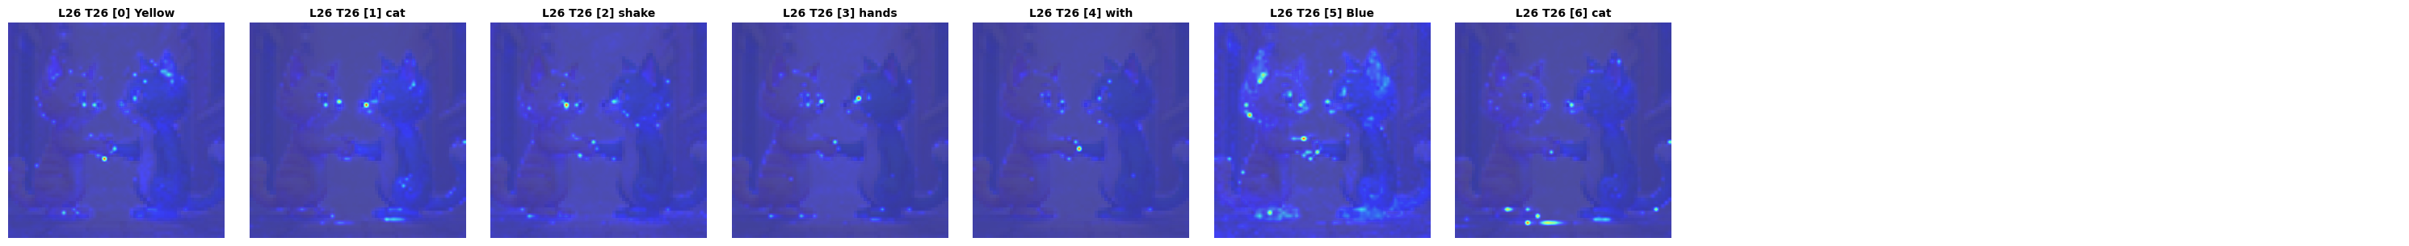
Last Week
L0
L6
L12
L16
L20
L26

Slide 4
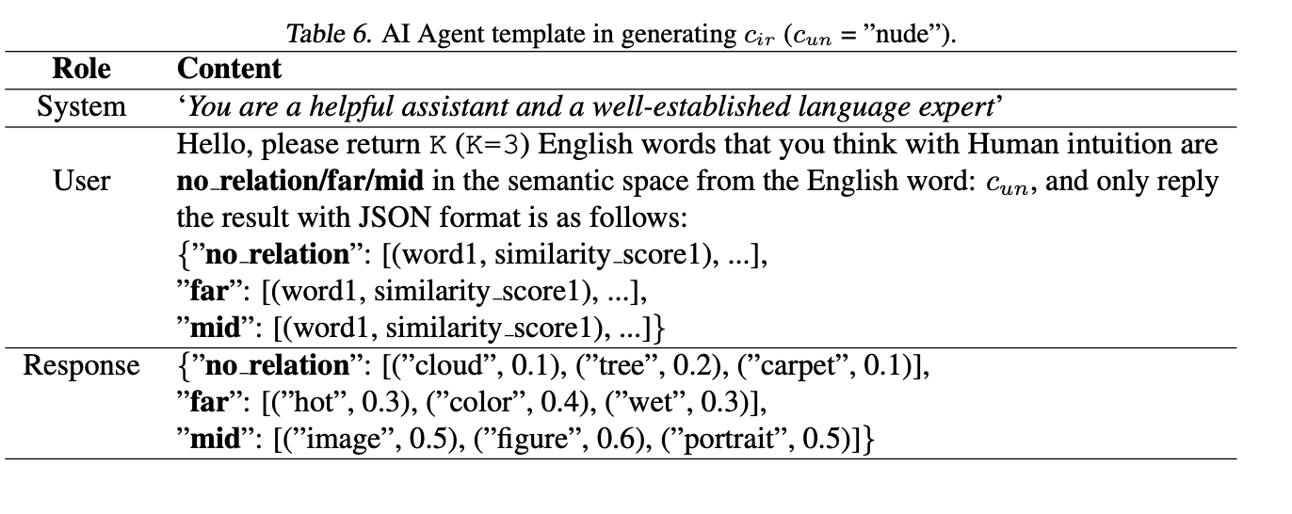
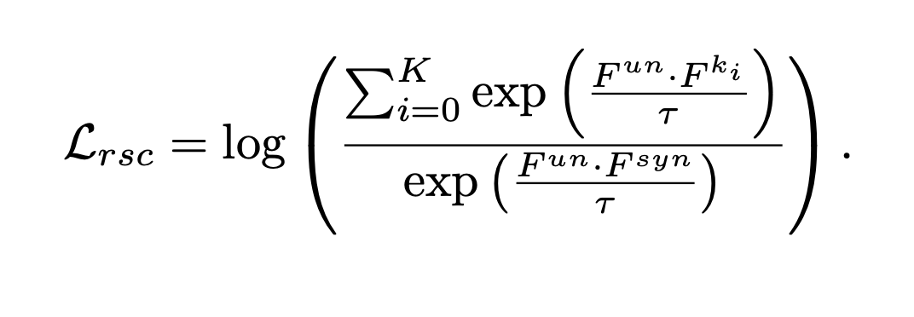

Concept Space
지우려는 개념의 표현 $F^{un}$이 동의어 표현 $F^{syn}$보다, 무관한 개념들 $F^{ki}$과 더 가깝도록 강제하는 손실
{
"synonym": {
"word": "Vegetable",
"similarity": 0.8
},
"no_relation": [
{"word": "Sun", "domain": "Nature", "similarity": 0.2},
{"word": "Hope", "domain": "Abstract Logic", "similarity": 0.3},
{"word": "Painting", "domain": "Arts", "similarity": 0.4}
],
"far": [
{"word": "Kitchen", "domain": "Food Preparation", "similarity": 0.6},
{"word": "Fork", "domain": "Tableware", "similarity": 0.7},
{"word": "Fridge", "domain": "Food Storage", "similarity": 0.8}
],
"mid": [
{"word": "Apple", "domain": "Fruit", "similarity": 0.9},
{"word": "Orange", "domain": "Fruit", "similarity": 0.9},
{"word": "Banana", "domain": "Fruit", "similarity": 0.9}
]
}

Slide 5
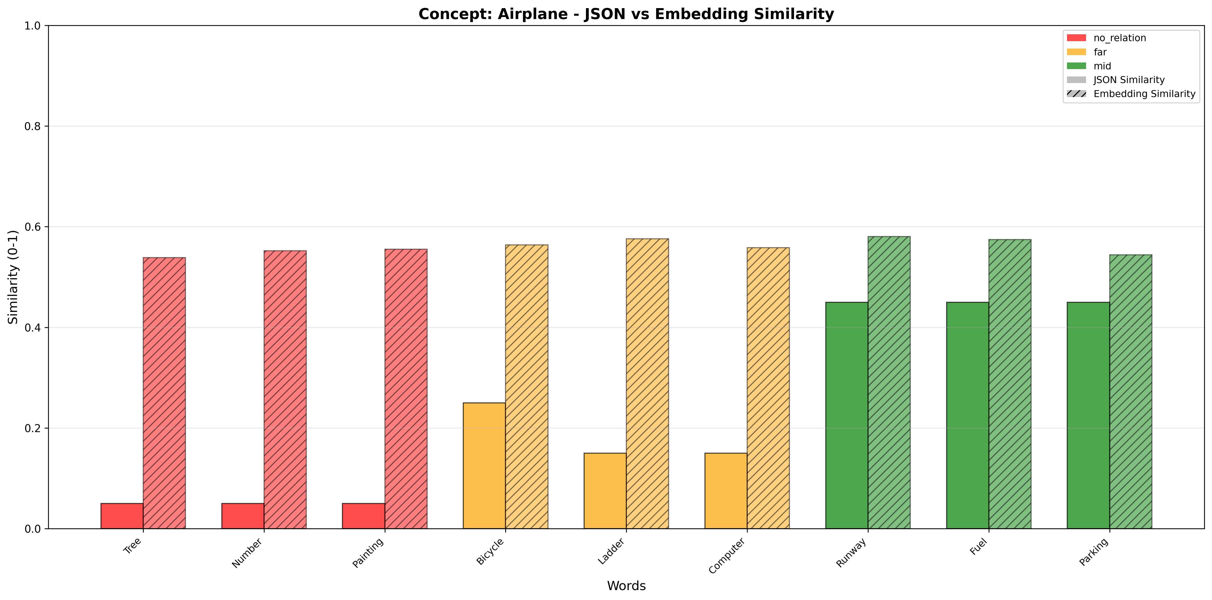
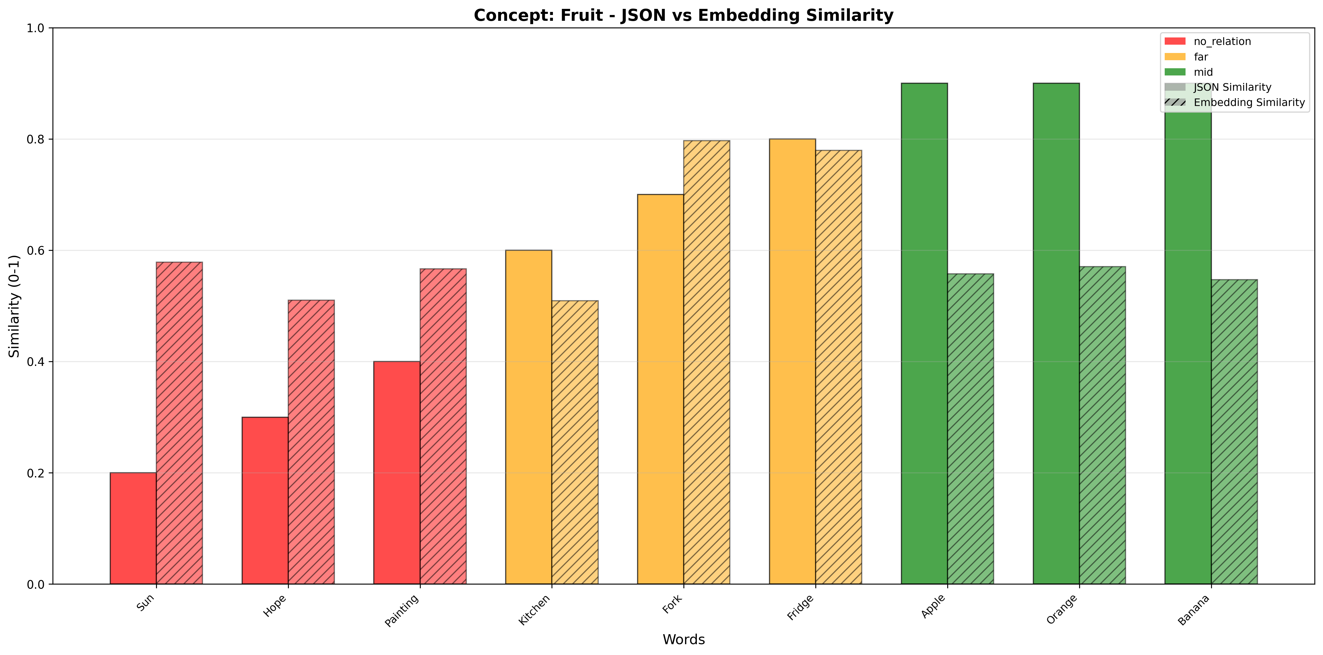
Concept Space
"concept": "Airplane",
"category": "Entity",
"index": 3,
"data": {"target_domain": "Transportation", "synonym": {"word": "Aircraft", "similarity": 0.95},
"no_relation": [
{"word": "Tree", "domain": "Nature", "similarity": 0.05},
{"word": "Number", "domain": "Abstract Logic", "similarity": 0.05},
{"word": "Painting", "domain": "Arts", "similarity": 0.05}
],
"far": [
{"word": "Bicycle", "domain": "Transportation", "similarity": 0.25},
{"word": "Ladder", "domain": "Architecture", "similarity": 0.15},
{"word": "Computer", "domain": "Electronics", "similarity": 0.15}
],
"mid": [
{"word": "Runway", "domain": "Transportation", "similarity": 0.45},
{"word": "Fuel", "domain": "Transportation", "similarity": 0.45},
{"word": "Parking", "domain": "Transportation", "similarity": 0.45}
],
"concept": "Fruit",
"category": "Entity",
"index": 0,
"data": {"target_domain": "Food", "synonym": { "word": "Vegetable", "similarity": 0.8},
"no_relation": [
{"word": "Sun", "domain": "Nature", "similarity": 0.2},
{"word": "Hope", "domain": "Abstract Logic", "similarity": 0.3},
{"word": "Painting", "domain": "Arts", "similarity": 0.4}
],
"far": [
{"word": "Kitchen", "domain": "Food Preparation", "similarity": 0.6},
{"word": "Fork", "domain": "Tableware", "similarity": 0.7},
{"word": "Fridge", "domain": "Food Storage", "similarity": 0.8}
],
"mid": [
{"word": "Apple", "domain": "Fruit", "similarity": 0.9},
{"word": "Orange", "domain": "Fruit", "similarity": 0.9},
{"word": "Banana", "domain": "Fruit", "similarity": 0.9}
],

Slide 6
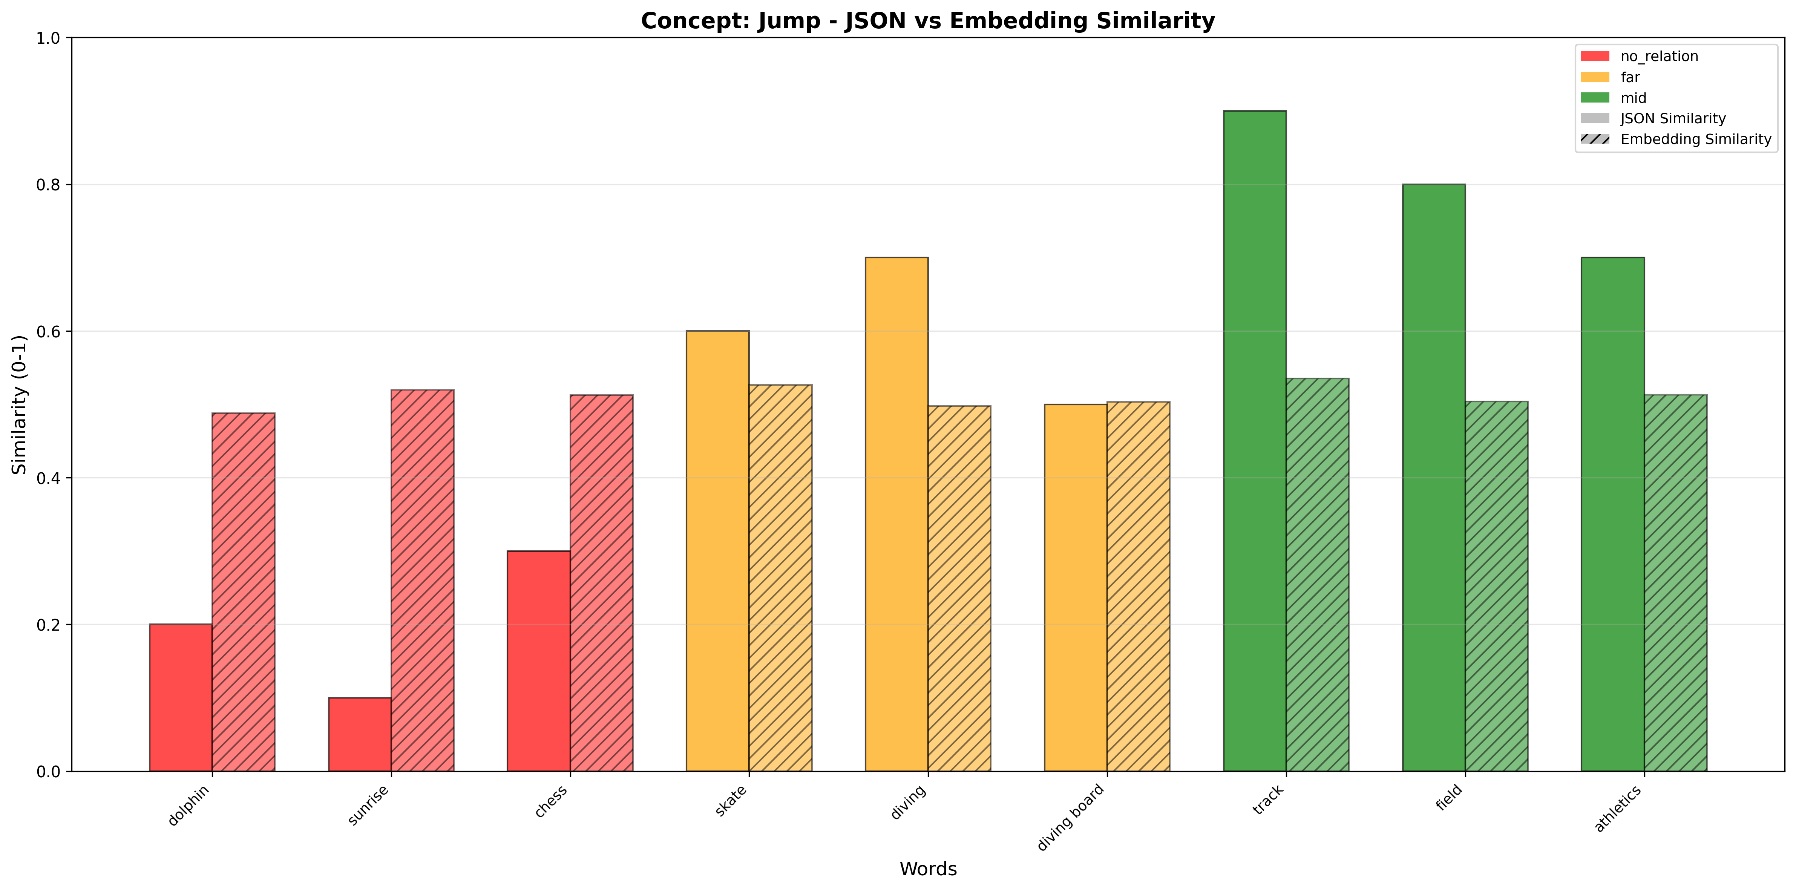
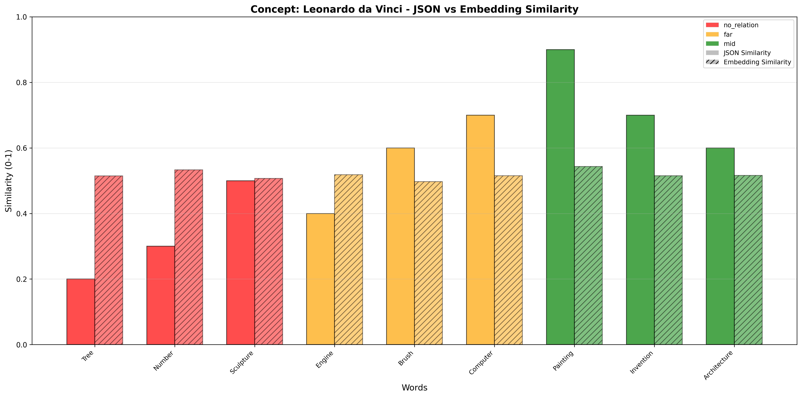
Concept Space

Slide 7
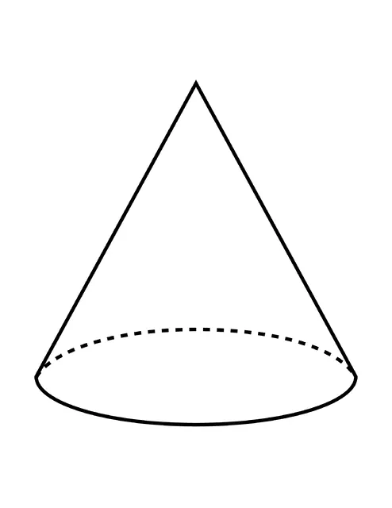
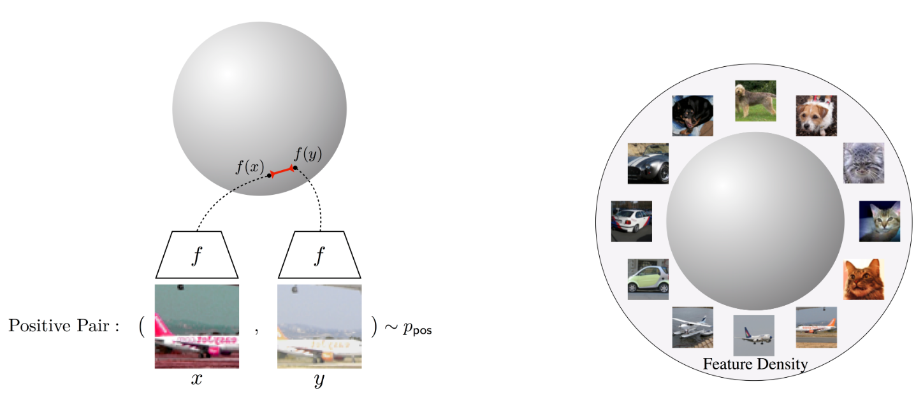
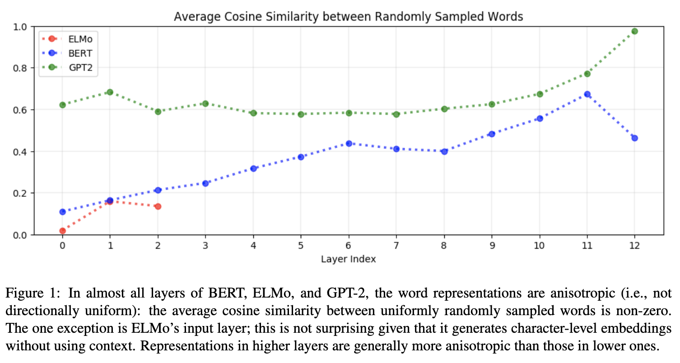
Concept Space
@CLIP (Contrastive Learning)
@LLM text_encoders
* How Contextual are Contextualized Word Representations? Comparing the Geometry of BERT, ELMo, and GPT-2 Embeddings (ACL, 2019)
** Gao et al. (2019) - "Representation Degeneracy Problem in Training Natural Language Generation Models”
*** Locating and Editing Factual Associations in GPT (2023)

Slide 8
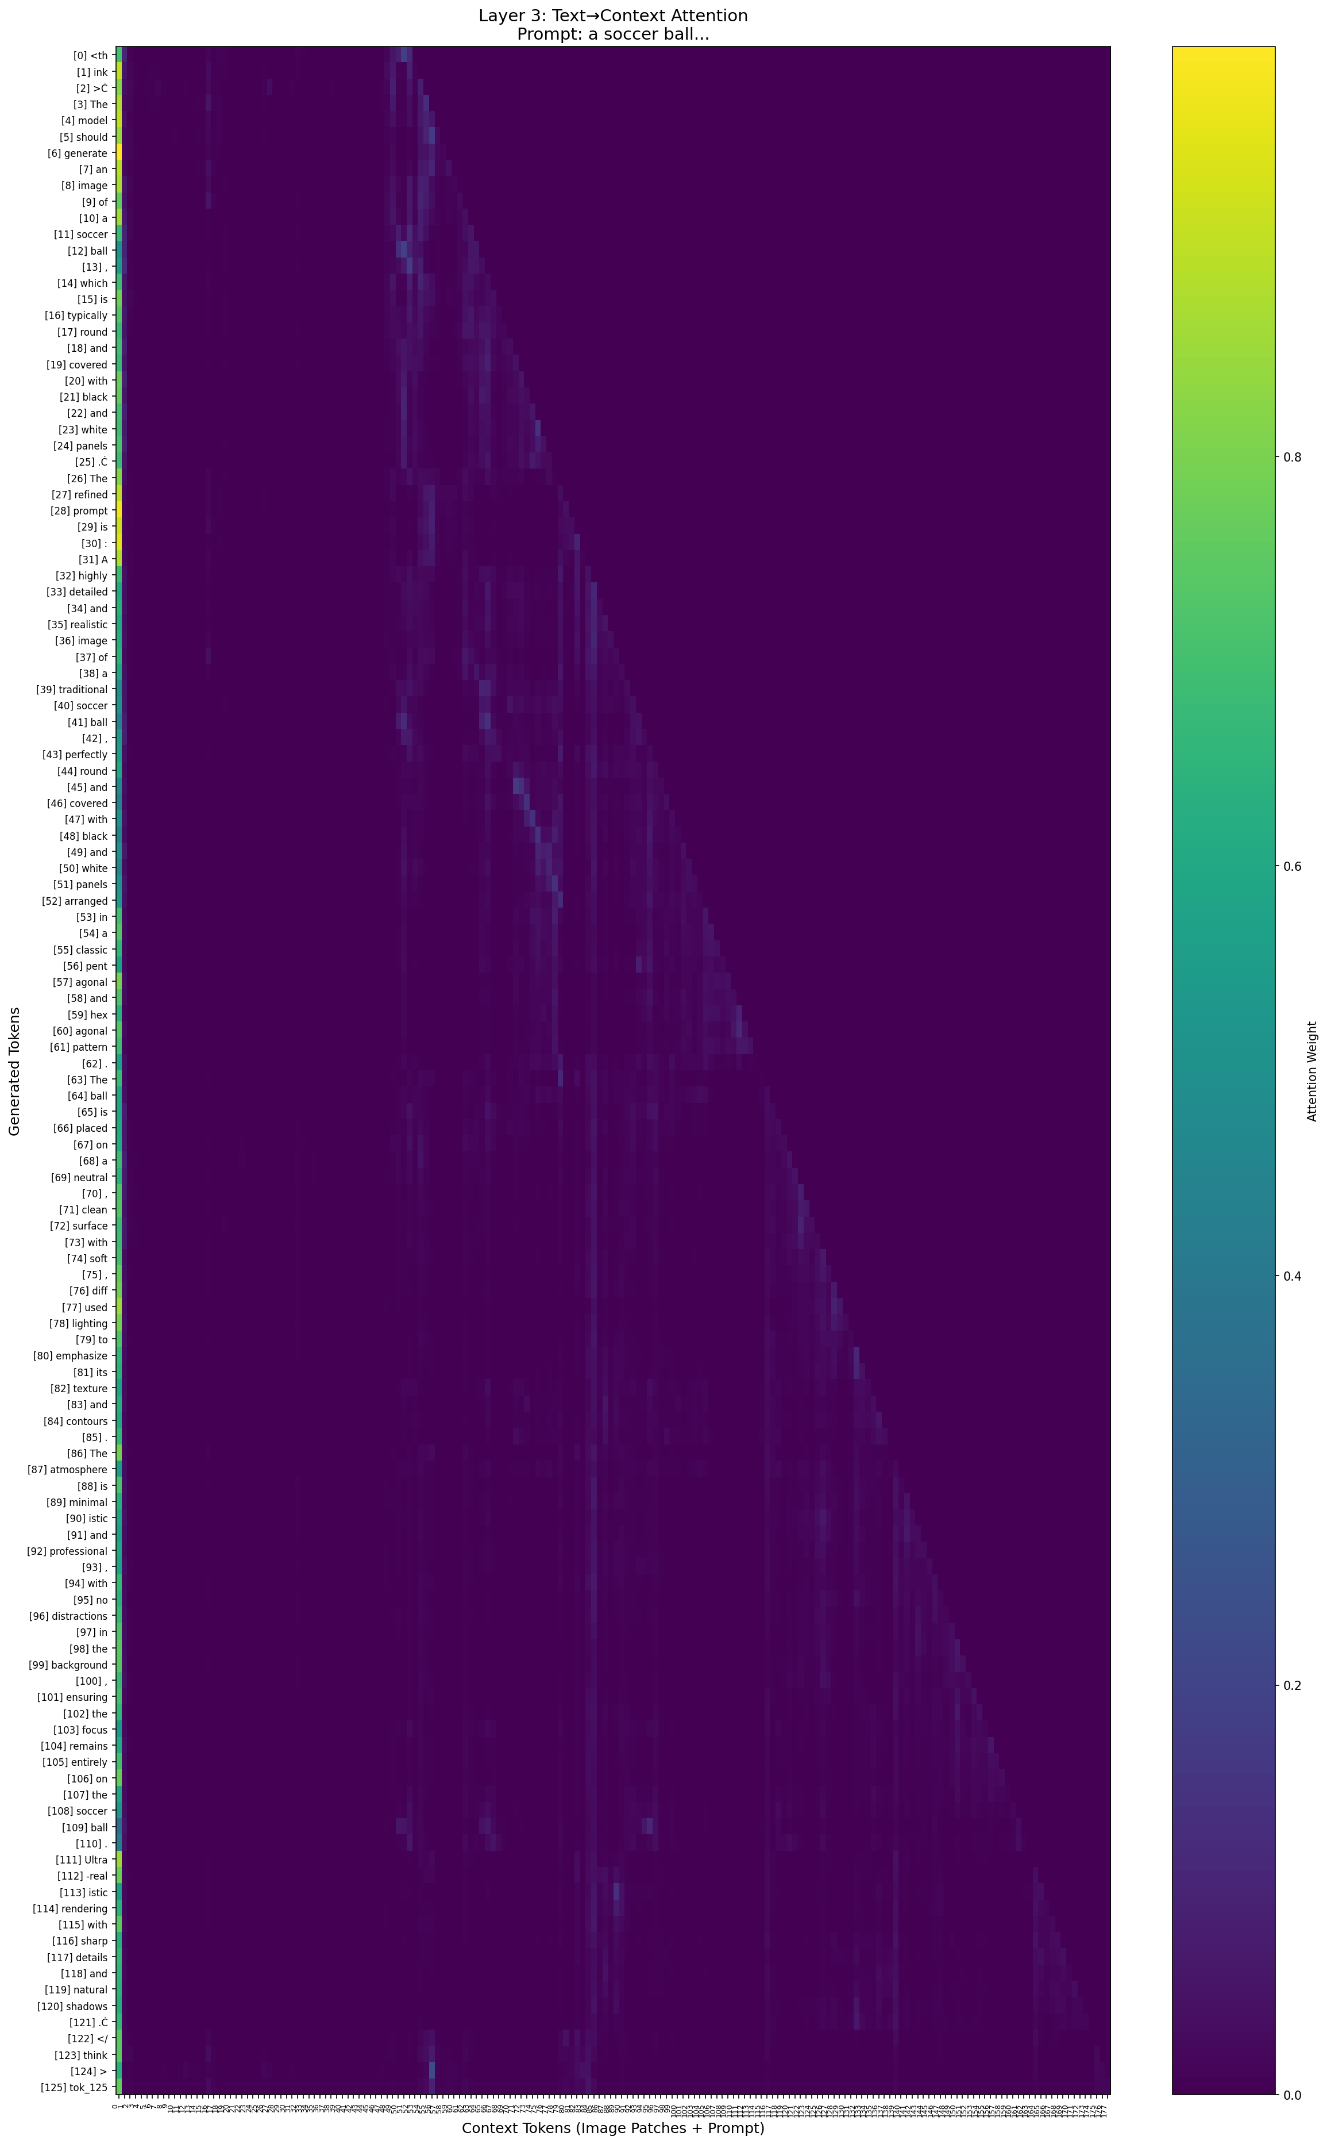
Txt-to-Context Self-Attention

Slide 9
Method - Loss
Hypothesis
Loss
# TODO
언러닝 Hypothesis – Loss 아이디어 정리해가기
그 Hypothesis 검증을 위해선 어떤 실험을 해야하는지 정리하기
EraseAnything 적용 결과
Minimalist 논문 PPT로 정리해보기

Slide 10
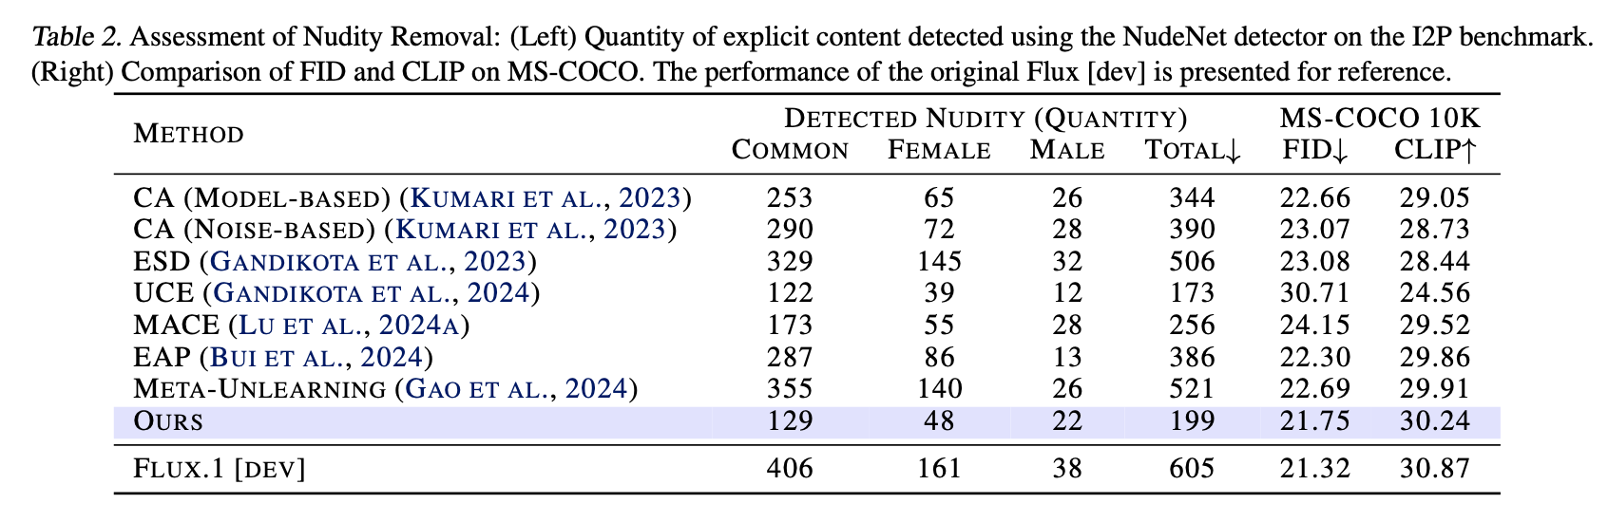
* Nude, Violence in BAGEL
* EraseAnything: Enabling Concept Erasure in Rectified Flow Transformers (ICML, 2025)
// ‘Nude’ – nudenet (320x320)
BAGEL Generation w/ Think
BAGEL Generation w/o Think
// ‘Violence’ - Q16 (224x224)
BAGEL Generation w/ Think | 534 / 4703 (11.35%)
BAGEL Generation w/o Think
→ Original SD: 60.4% (w/ SC: 56.8%)
detector들의 input size보다 4배나 큰 BAGEL 이미지들. (1024x1024)
그래서 세부적인 부분을 감지하지 못할 가능성 있음
확인해보니 512*512 가능한 듯 #TODO: 데이터센터에 512*512 버전으로 I2P 다시 생성, 평가

Slide 11
* Plan
Memorization
Previous Works cannot resolve this phenomenon?
More Training Experiments on More Classes/Instances
‘dvddog’
Temporal Analysis
Compared btw ‘Dominating’ and ‘Others’
Should be Compared btw ‘Dominanting’ and ‘Dominated’
Additional Experiments on SD2.1 (All Analysis Part)
Fine-tuning experiment
Focus score
Temporal Analysis
Head Ablation
Strengthen the minor argument
Concept Erasing in UMM
Apply baseline Methods: SPEED, EraseAnything, …
Discover “Think” mode
Milestone
Rebuttal (Jan, 22, 2026) – 3 weeks
Concept Erasing in UMM
* scholarship

Slide 12
CVPR 2026 Submission
Previous Works cannot resolve this phenomenon?
More Training Experiments on More Classes/Instances
‘dvddog’ and more
Does size of the content in training data matters?
Temporal Analysis
Compared btw ‘Dominating’ and ‘Others’
Should be Compared btw ‘Dominanting’ and ‘Dominated’
Additional Experiments on SD2.1 (All Analysis Part)
Fine-tuning experiment
Focus score
Temporal Analysis
Head Ablation
Strengthen the minor argument
intra-category cosine distances – Try more training images
Head ablation - Others 카테고리에 대한 추가 분석
Dominated Token에 대해서 Layer 7를 추적하는 이유
Ablation Study (epsilon, LPIPS/SSCD threshold)

